Slide 1
Interactive teaching
of crystallography using Jmol
Robert M. Hanson
St. Olaf College, Northfield, MN
http://www.stolaf.edu/people/hansonr
hansonr@stolaf.edu
MS-016.001.632
24th Congress of the International Union of Crystallography
Hyderabad, India
Aug 22, 2017

Slide 2
Outline
Quick Introduction to Jmol/JSmol
Two types of challenges in crystallographic education
The use of 3D models to help convey crystallographic concepts

Slide 3
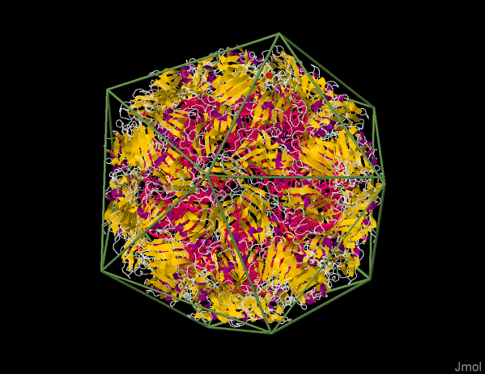
Quick Introduction to Jmol
Mission: The high-quality, real-time interactive visualization of molecular structure, dynamics, and energetics.
open source Java (Jmol)/ JavaScript (Jsmol)
development driven by user input
Jmol-users@sourceforge.net
hansonr@stolaf.edu

Slide 4
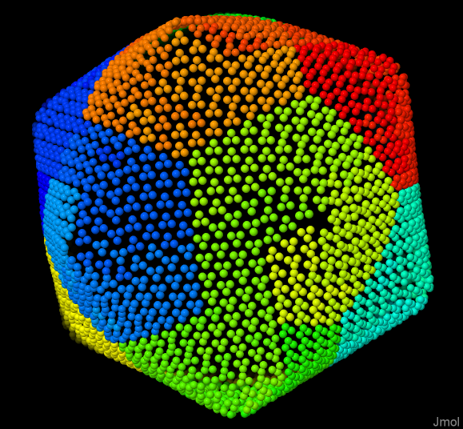
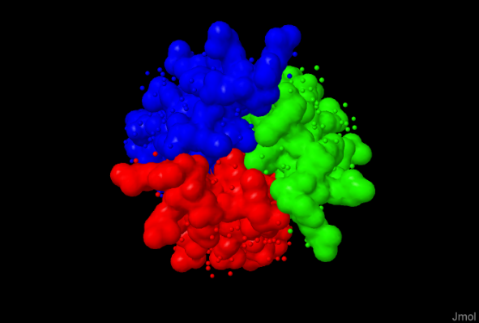
Quick Introduction to Jmol
small molecules
macromolecules
crystalline materials
reads PDB, CIF, CIF2, mmCIF, mCIF, magCIF, MMTF, and many other file formats
leverages a wide variety of servers
electron density and electron microscopy maps
course graining based on chain or symmetry
simultaneous load of validation data

Slide 5
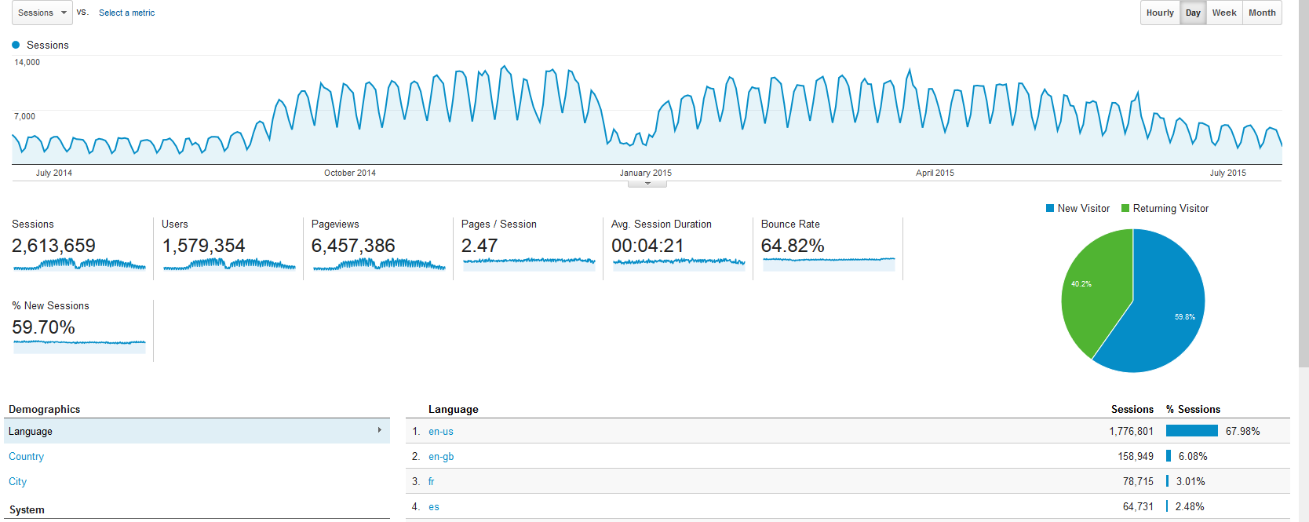
Jmol/JSmol Exposure (Jul 2014-Jul 2015)

Slide 6
Challenges for Crystallographic Education
“Type 1” (technical) challenges:
Symmetry operations
Miller planes and reciprocal space
Lattice types, unit cells, Brillouin zones
Incommensurate modulation and quasicrystals
Dynamic phenomena such as vibrations, phonons, and solid-solid phase changes
“Type 2” (critical thinking) challenges:
Electron density vs. model
Structure validation
hansonr@stolaf.edu

Slide 7
Type 1 challenges: Symmetry Operators
Problem: How can we assist in the development of crystallographic understanding using interactive technology?
Solution: Embedded JSmol apps within web pages allow for creative customization of lessons.

Slide 8
Type 1 challenges: Symmetry Operators
Problem: How can we assist in the development of crystallographic understanding using interactive technology?
Solution: Embedded JSmol apps within web pages allow for creative customization of lessons.
Bonus: Embedded web apps
allow world-wide impact.

Slide 9
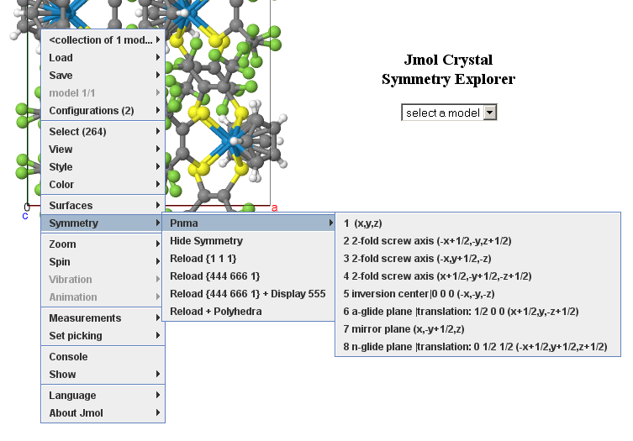
Type 1 challenges: Symmetry Operators
Example: Jmol Crystal Symmetry Explorer

Slide 10
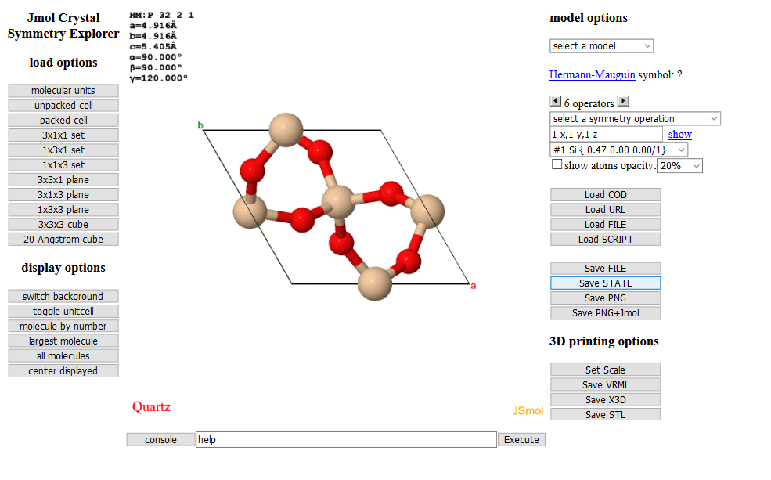
Type 1 challenges: Symmetry Operators
Example: Jmol Crystal Symmetry Explorer

Slide 11
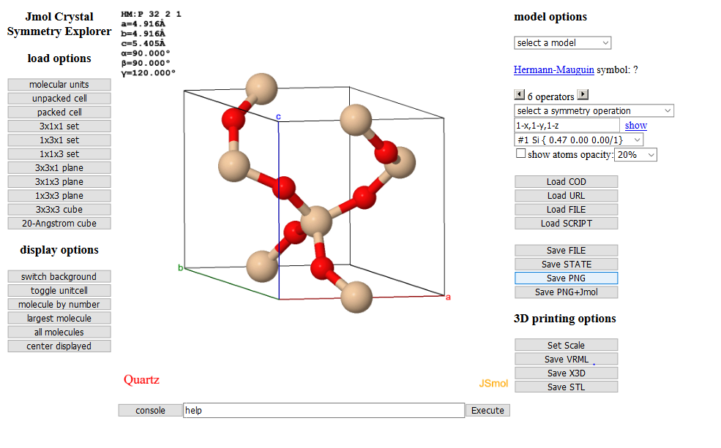
Type 1 challenges: Symmetry Operators
Example: Jmol Crystal Symmetry Explorer

Slide 12
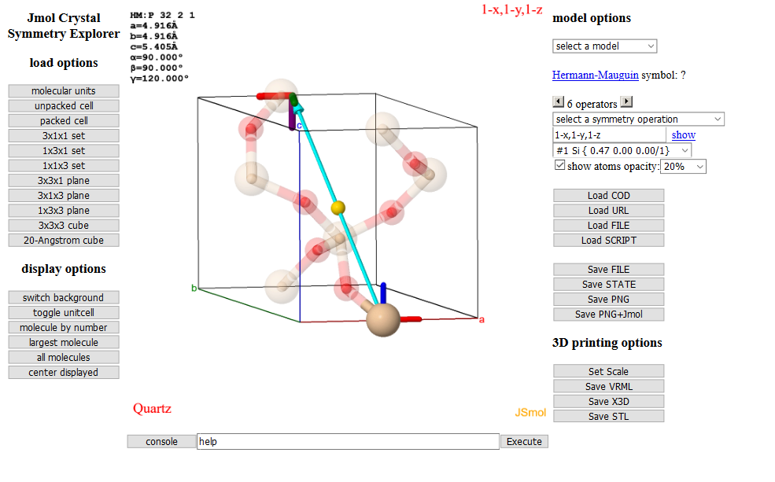
Type 1 challenges: Symmetry Operators
Example: Jmol Crystal Symmetry Explorer

Slide 13
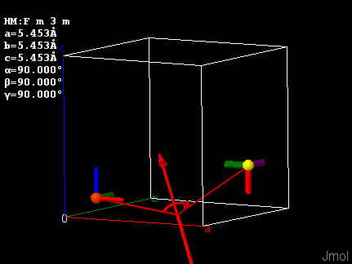
Type 1 challenges: Symmetry Operators
Drawing the operator for any two symmetry-related atoms
draw symop @1 @10

Slide 14
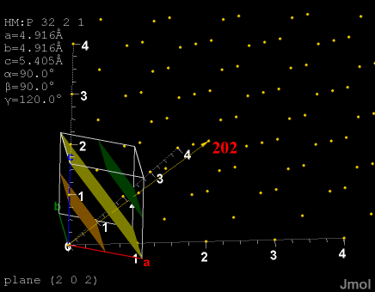
Type 1 challenges: Miller Planes
Miller plane families

Slide 15
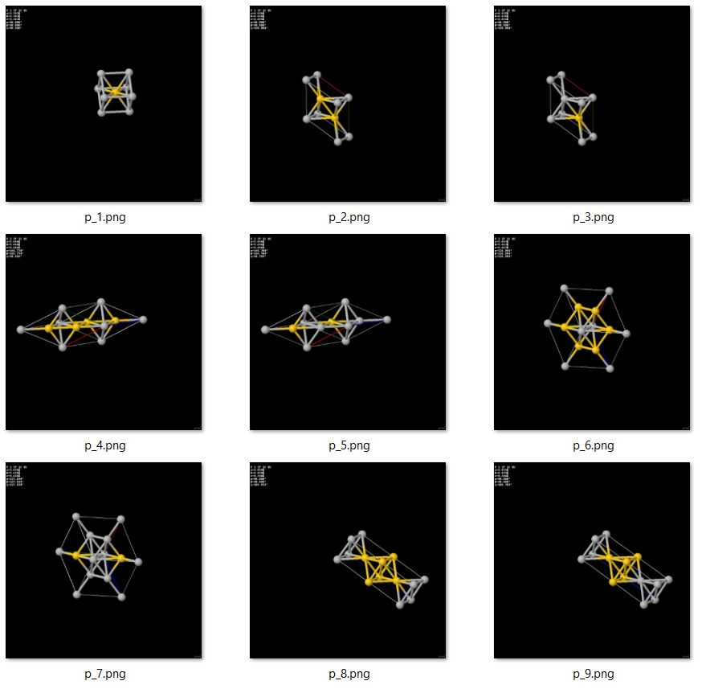
Type 1 challenges: Unit Cells
Problem: Primitive cells are important for calculation, but they are not particularly informative in terms of structure.
load models ({32:40})
agau.aflow packed

Slide 16
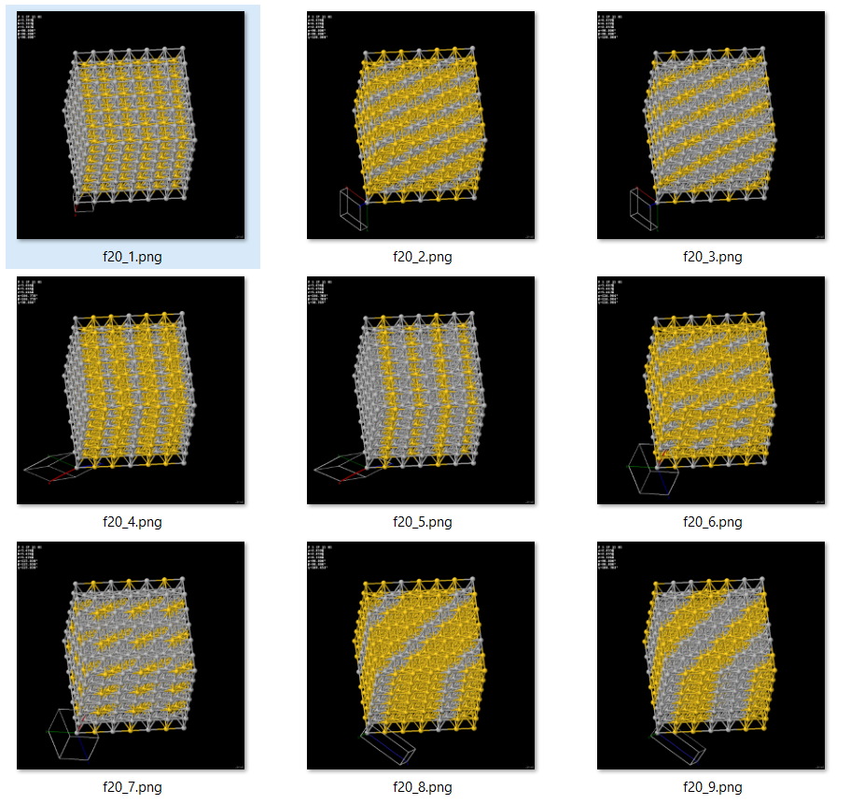
Type 1 challenges: Unit Cells
Problem: Primitive cells are important for calculation, but they are not particularly informative in terms of structure.
Solution: Fill a 20 x 20 Angstrom box instead.
load models ({32:40})
agau.aflow fill 20

Slide 17
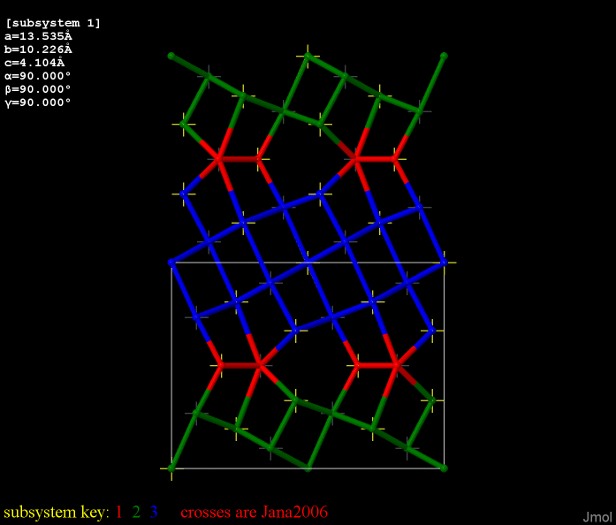
Type 1 challenges…
Commensurate Subsystems

Slide 18
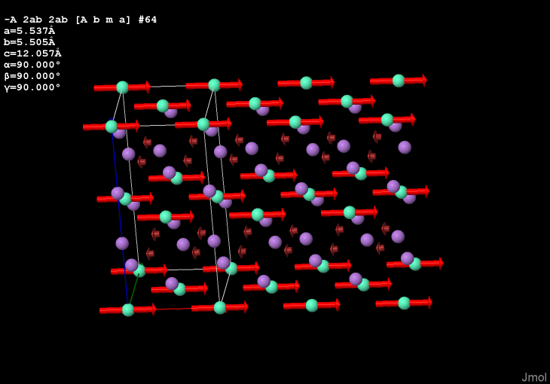
Type 1 challenges…
Magnetic CIF (magCIF) file reading with vector display

Slide 19
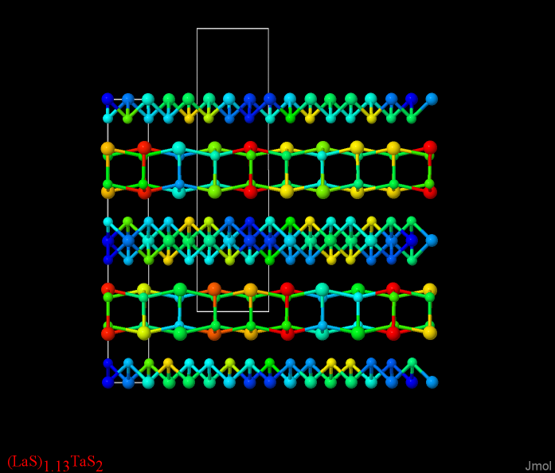
Type 1 challenges…
Incommensurately modulated structures

Slide 20
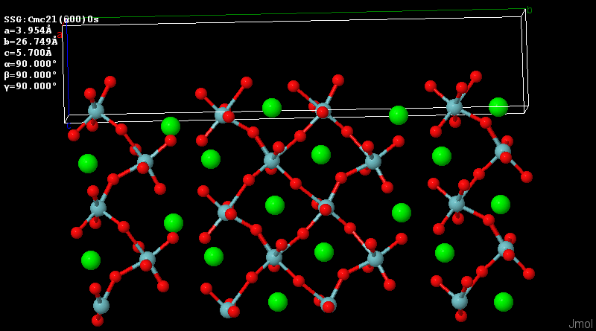
Type 1 challenges…
Incommensurately modulated structures
(modulations magnified by a factor of 10)

Slide 21
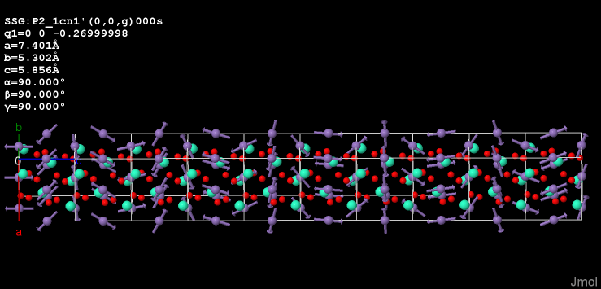
Type 1 challenges…
Incommensurately modulated structures (magnetic)

Slide 22
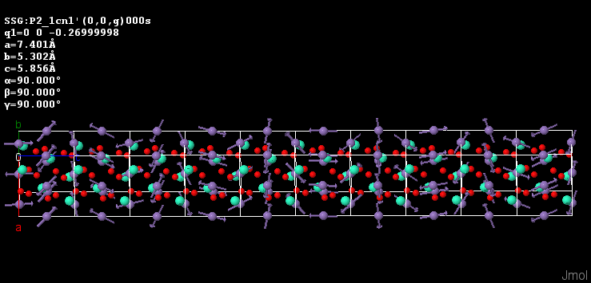
Type 1 challenges…
Incommensurately modulated structures (magnetic)

Slide 23
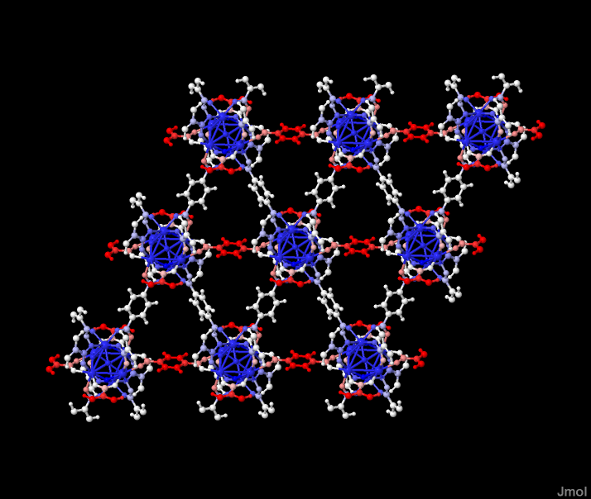
Type 1 challenges…
Vibrational/phonon mode visualization

Slide 24
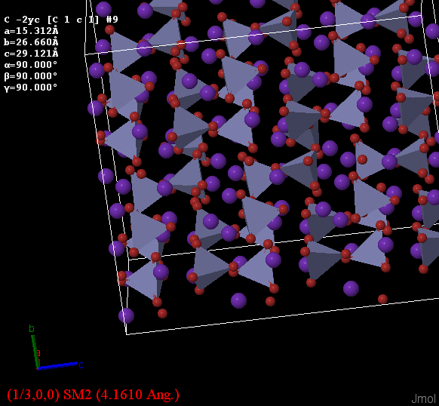
Type 1 challenges…
Solid-state phase changes

Slide 25
Type 2 challenges
Electron Density
Models
Structure validation

Slide 26
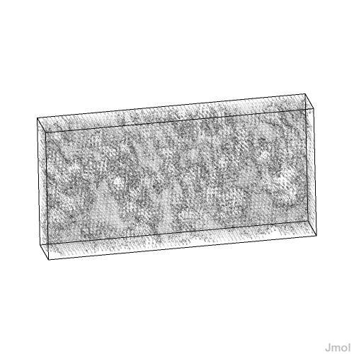
Type 2 challenges: Electron Density
Discussing electron density
Show actual crystallographic electron density data, and allow for dynamic clipping based on sigma values.

Slide 27
Type 2 challenges: Electron Density
Discussing electron density
Show actual crystallographic electron density data, and allow for dynamic clipping based on sigma values.

Slide 28
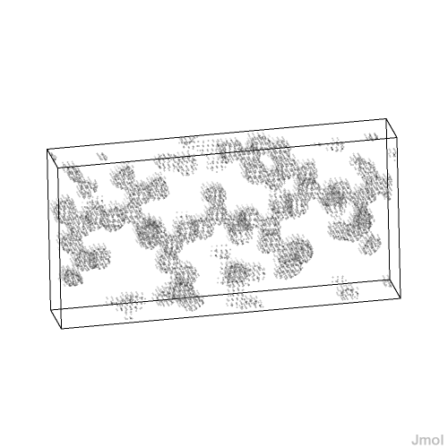
Type 2 challenges: Electron Density
Discussing electron density
Show actual crystallographic electron density data, and allow for dynamic clipping based on sigma values.

Slide 29
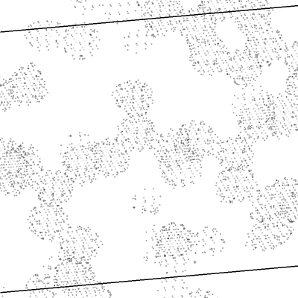
Type 2 challenges: Electron Density
Discussing electron density
Show actual crystallographic electron density data, and allow for dynamic clipping based on sigma values.

Slide 30
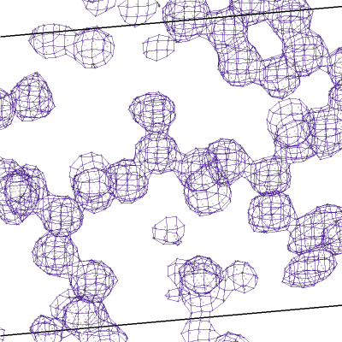
Type 2 challenges: Electron Density
Discussing electron density
Show actual crystallographic electron density data, and allow for dynamic clipping based on sigma values.

Slide 31
Type 2 challenges: Models
Q: What is a model?

Slide 32

Google: Models

Slide 33
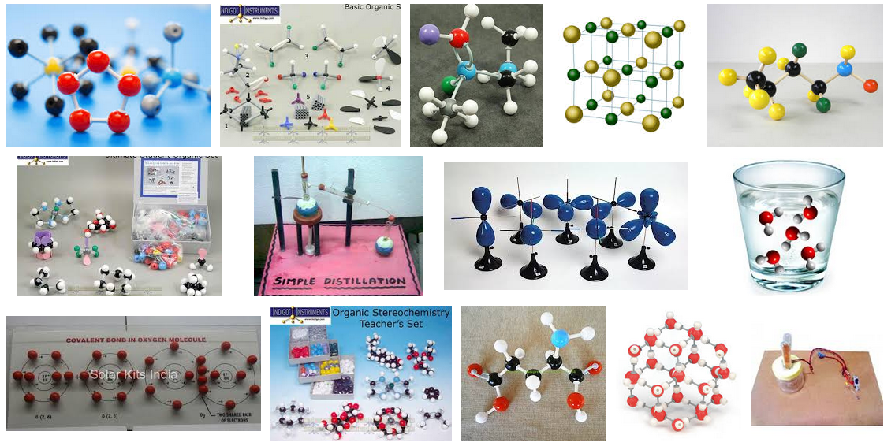
Google: Models Chemistry

Slide 34
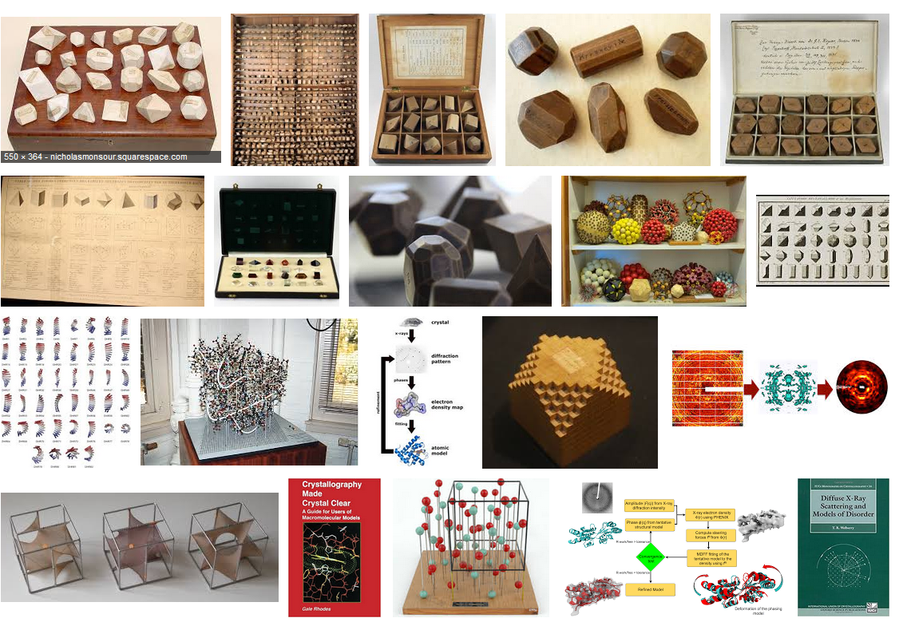
Google: Models Crystallography

Slide 35
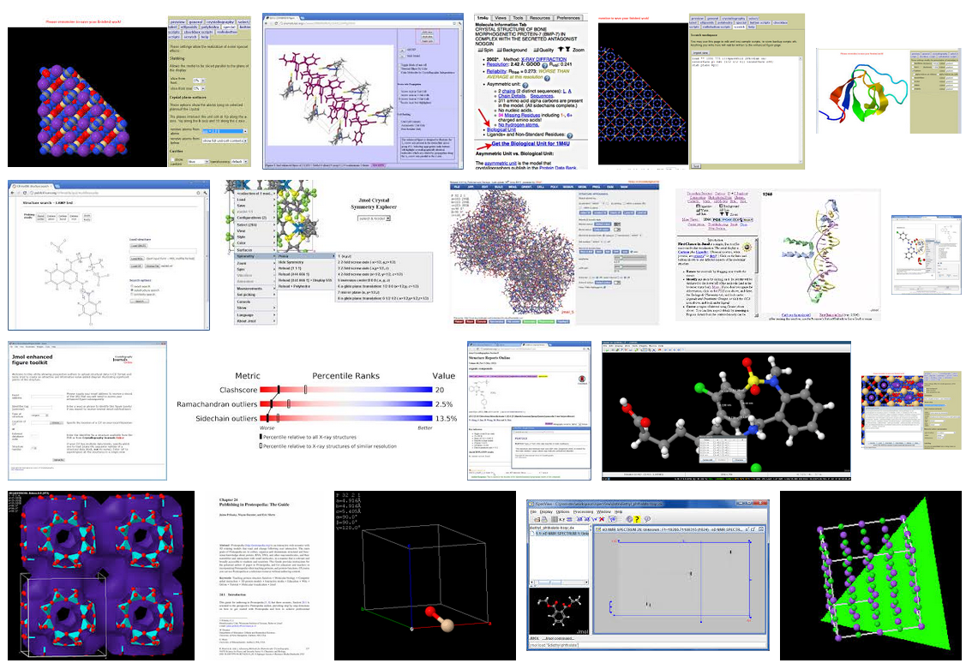
Google: Models Crystallography Jmol

Slide 36
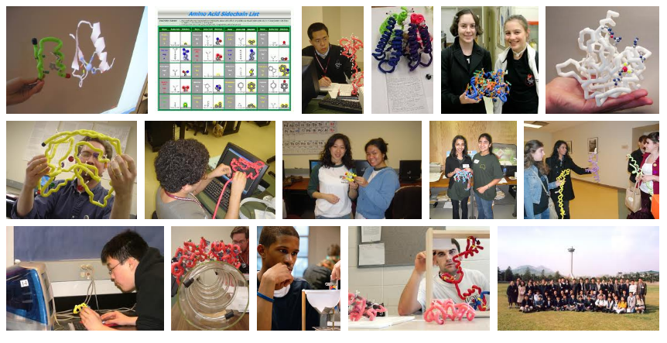
3D-Printed Models

Slide 37
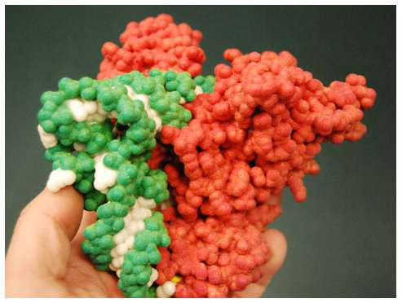
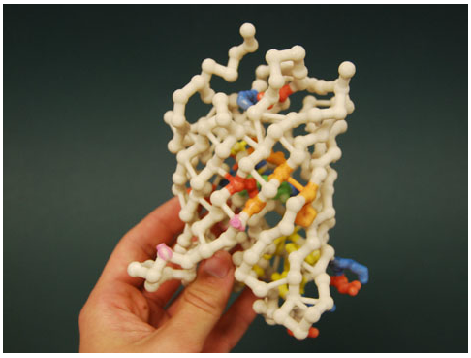
3D-Printed Models

Slide 38
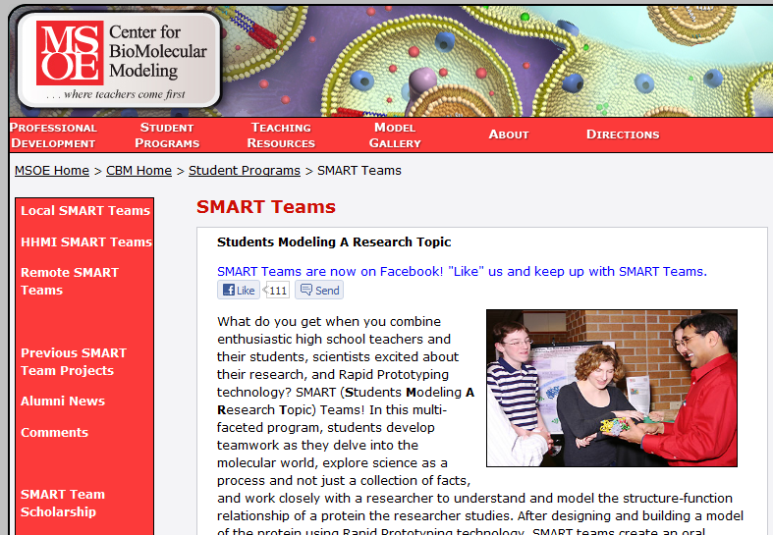

Slide 39
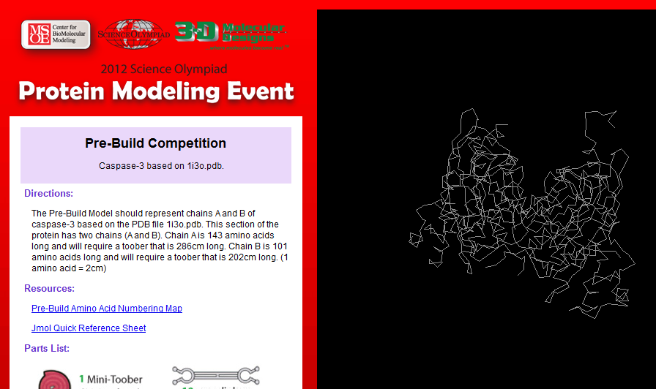

Slide 40
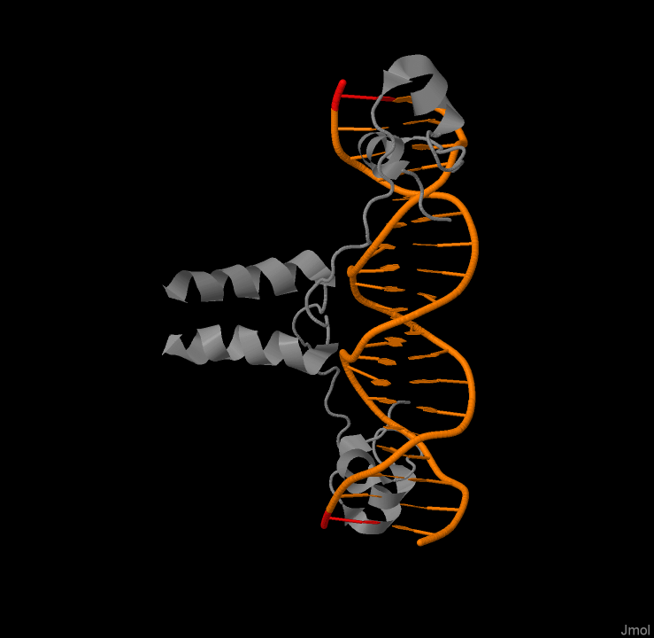
Type 2 challenges: Models
1d66 – protein-DNA transcription complex
load =1d66
cartoons only
color structure

Slide 41
Type 2 challenges: Models
1d66 -- 1992 study inadvertently flipped nucleotide base in reported model

Slide 42
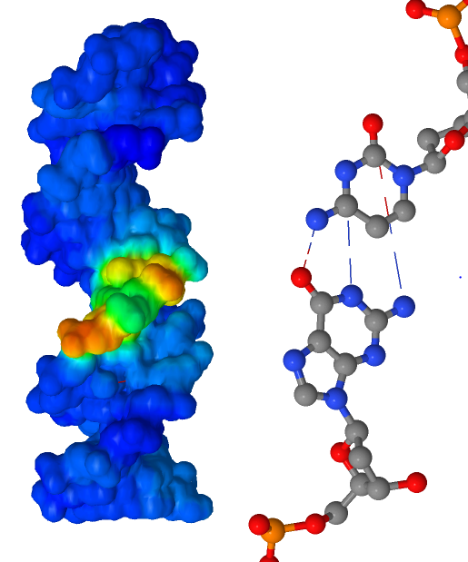
Type 2 challenges: Models
1d66 -- 1992 study inadvertently flipped nucleotide base in reported model
isosurface select {dna} only sasurface map property straightness

Slide 43
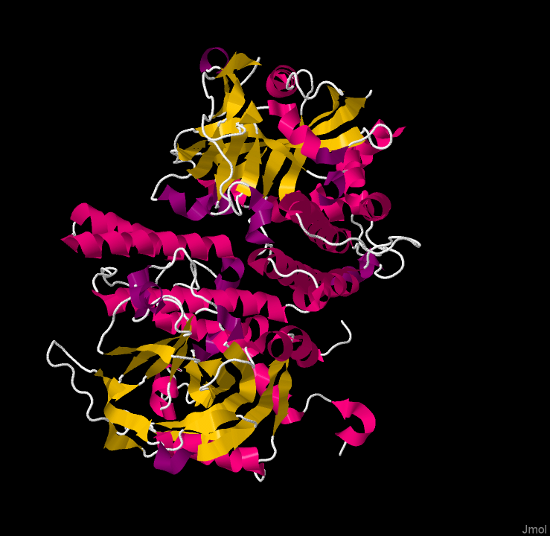
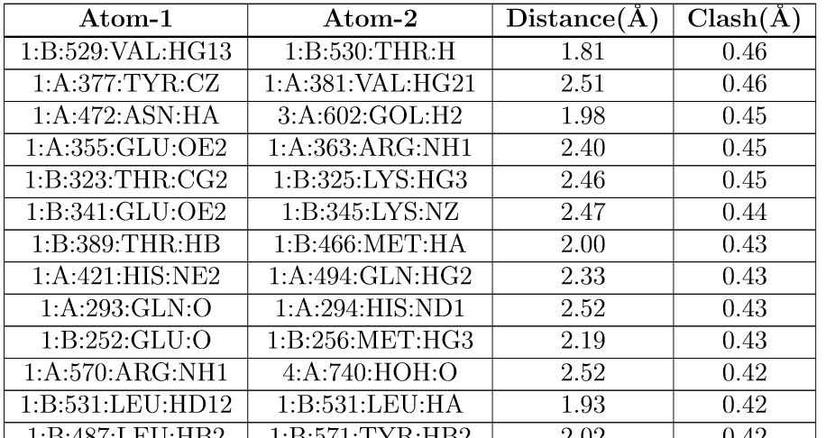
Type 2: Validation
load =4tvj
cartoons only
color structure

Slide 44
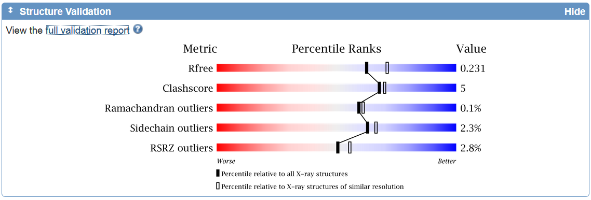
Type 2: Validation
load =4tvj
cartoons only
color structure

Slide 45
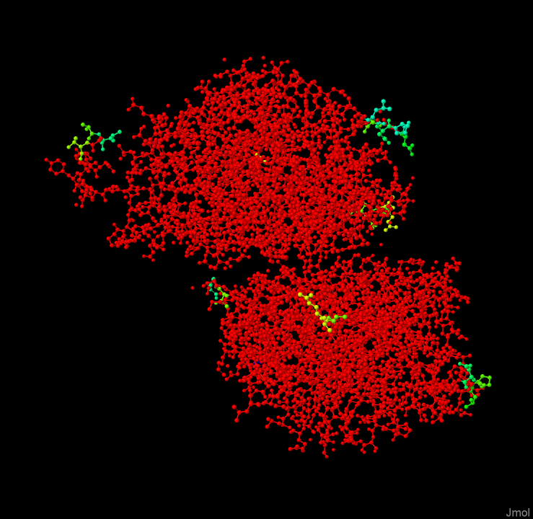
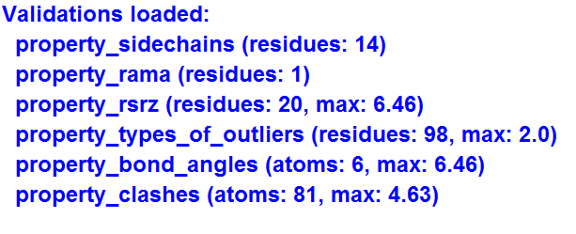
Type 2: Validation
load *4tvj/val
color property_rsrz

Slide 46
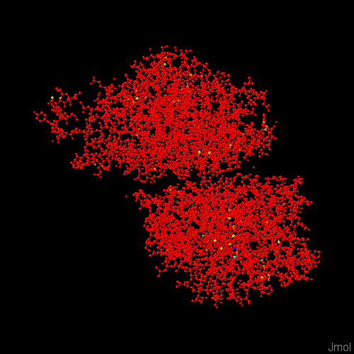
Type 2: Validation
load *4tvj/val
color property_clashes

Slide 47
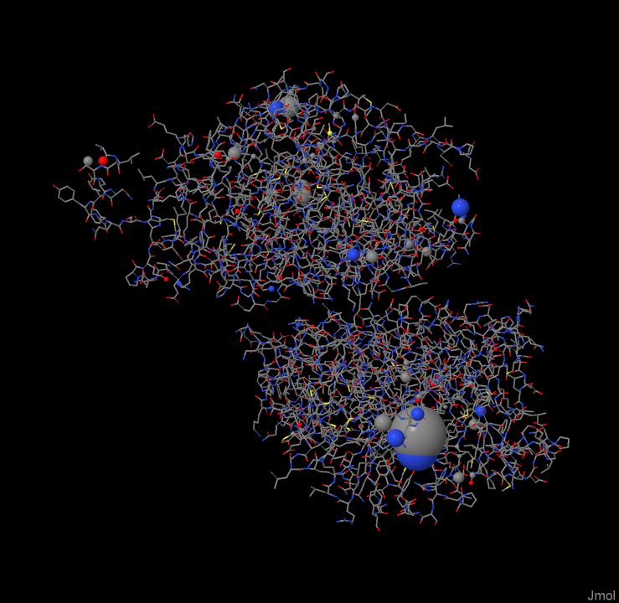
Type 2: Validation
load *4tvj/val
{*}.radius = {*}.property_clashes.all

Slide 48
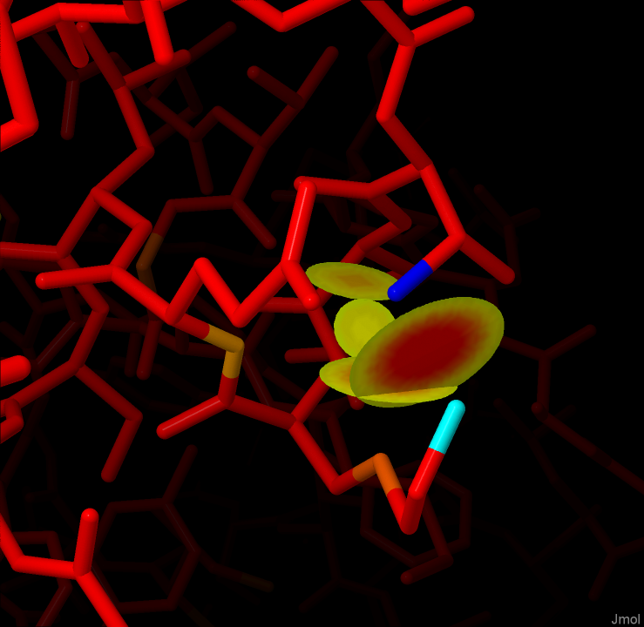
Type 2: Validation
load *4tvj/val
color property_clashes
contact {Lys325} {Thr323}

Slide 49
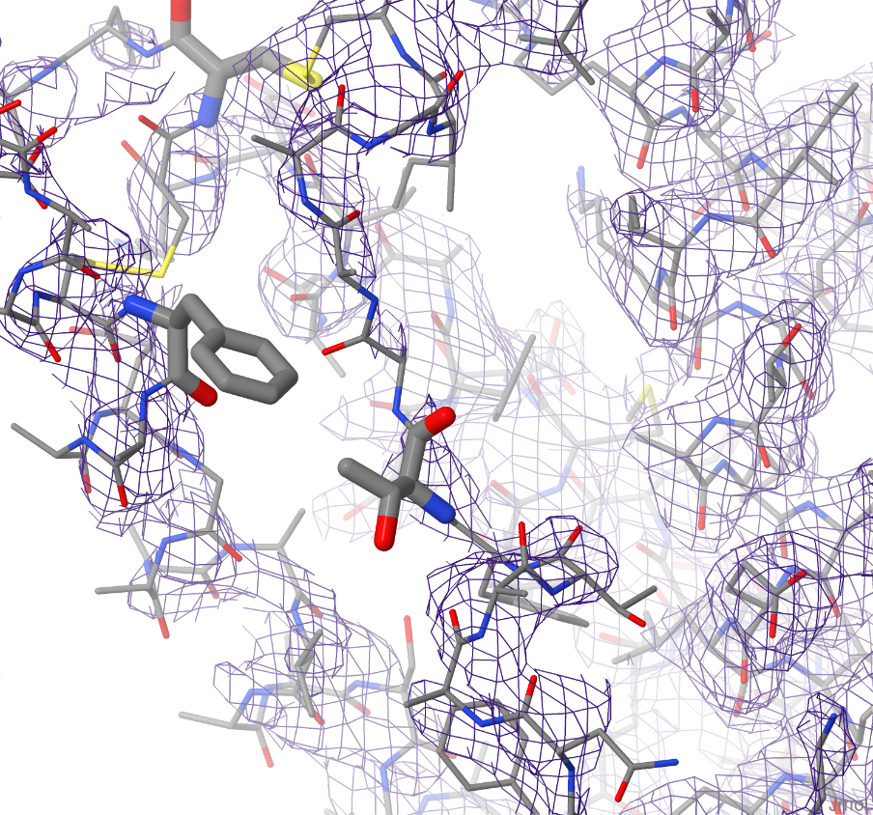
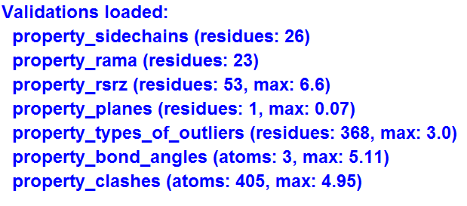
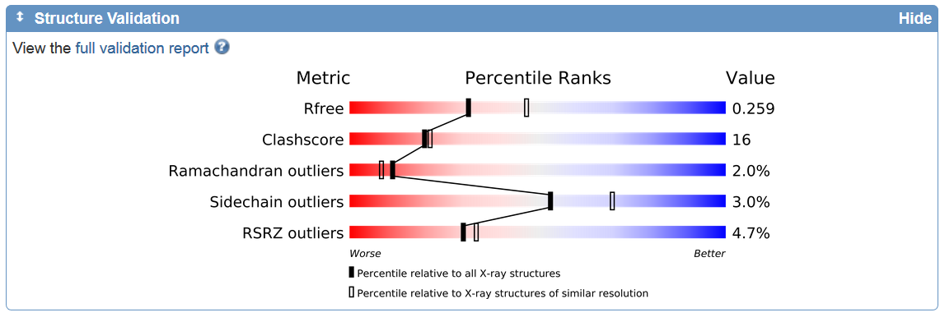
Type 2: Validation
load *2bxa/val; wireframe only
select property_rsrz > 3; wireframe 0.2
Isosurface “=2bxa”

Slide 50
Summary
Crystallography is a visual science
Models help in working with 3D concepts
Both physical and virtual models have advantages

Slide 51
Summary
The real challenge is getting across what a “model” is, especially what its limitations are.
Web-based high-impact interactive educational materials have high exposure and lots of flexibility.

Slide 52
Acknowledgments
Peter and Judith Murray-Rust (Univ. Cambridge)
Sid Hall (UWA)
Gotzon Madariaga, Juan Manuel Peréz-Mato,
Mois Aroyo (EHU)
Sameer Velankar (EBI)
Tim Herman, Margaret Franzen, Mark Hoelzer (MSOE)
Edolph A. Larson and Truman E. Anderson, Sr. Chair of Chemistry (St. Olaf College)
Jmol users world-wide

